Slide 1

Sentiment Analysis on Twitter Data "A Machine Learning Approach to Analyzing Public Sentiments on Social Media"
Team Members:
Subhasmita Maharana
Mukthasree Vengoti
Chandini Karrothu
Pallavi Padam
Likhitha Marrapu

Slide 2

Introduction
Definition: Sentiment analysis leverages NLP and ML to categorize emotions in text data as positive, negative, or neutral.
Objective: Identify public sentiment patterns to inform business decisions, improve customer service, and analyze trends.

Slide 3
Project Motivation
Social Media’s Impact: Twitter holds vast, valuable data on public opinions across diverse topics.
Scalability: Automated sentiment analysis scales efficiently, providing timely insights.
Business Value: Companies can better understand customer sentiment, trends, and feedback.

Slide 4
Project Description
Primary Goal:
This project applies Natural Language Processing (NLP) techniques to perform sentiment analysis on Twitter data, classifying tweets as positive, negative, or neutral. Given that social media data is noisy traditional sentiment analysis often falls short. Therefore, the goal is to develop models capable of predicting sentiments for new, unseen tweets accurately.
Challenges:
The research had difficulties with unstructured and noisy Twitter data, necessitating a great deal of preprocessing to deal with unusual characters, hashtags, and informal language.
The process of extracting features was complicated; older approaches lacked context, while embeddings like BERT need more processing power. Lastly, choosing a model required weighing computational cost and performance while assessing both conventional and deep learning models, such as LSTM and BERT.

Slide 5
Background
Software Tools:
Integrated Development Environments (IDEs): Jupyter Notebook, Visual Studio Code or PyCharm
Libraries and Frameworks: scikit-learn, TensorFlow, or PyTorch. Natural Language Processing (NLP) libraries: NLTK, spaCy, or Stanford Core.
Related Programming Skills: Python, Machine Learning Techniques, Natural Language Processing, Data Visualizations.

Slide 6

Problem Definition
Problem: For our analysis of tweets from the Sentiment140 dataset, ready to characterize the sentiment classification issue as follows:
Sentiment Classification Problem: Given a tweet T, the goal is to classify it into one of three sentiment categories:
0 if T is negative
4 if T is positive
Data imbalance problem: The dataset may have imbalanced counts of various sentiment classes, resulting in biases in model predictions. If 𝑁0, 𝑁2, 𝑁4 are the counts of negative, neutral, and positive tweets respectively, then the total number of tweets is:
𝑁0 + 𝑁2 + 𝑁4= 1,600,000

Slide 7
General Solutions
Data Preprocessing
Balancing Methods
Advanced Methods
Ensemble Learning
Transfer Learning
Assessment Criteria

Slide 8

Data Overview
Assigns new column names to the dataframe- df.columns().
Displays the dimensions of the dataframe- df.shape()- has 1599999 rows and 6 columns.
Provides overview of the dataframe- df.info().
Checking for null values using is.null().
Checking for duplicate values using df.duplicated().
Displays unique categories, labels present in a column- df.unique(); and counts frequency of unique values- df.value_counts().

Slide 9
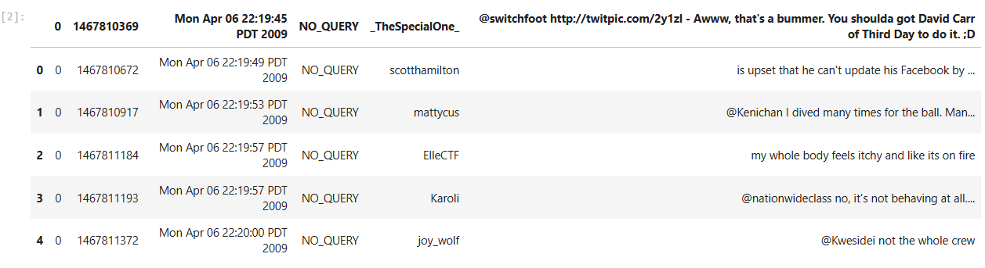
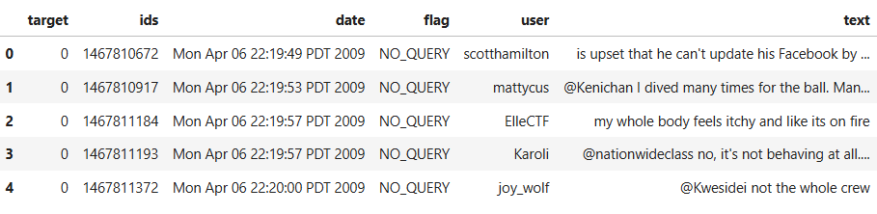
Dataset

Slide 10
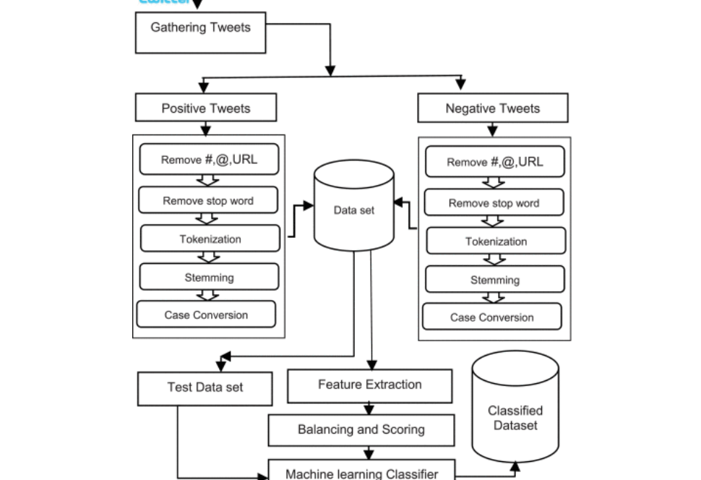
Flow Chart

Slide 11

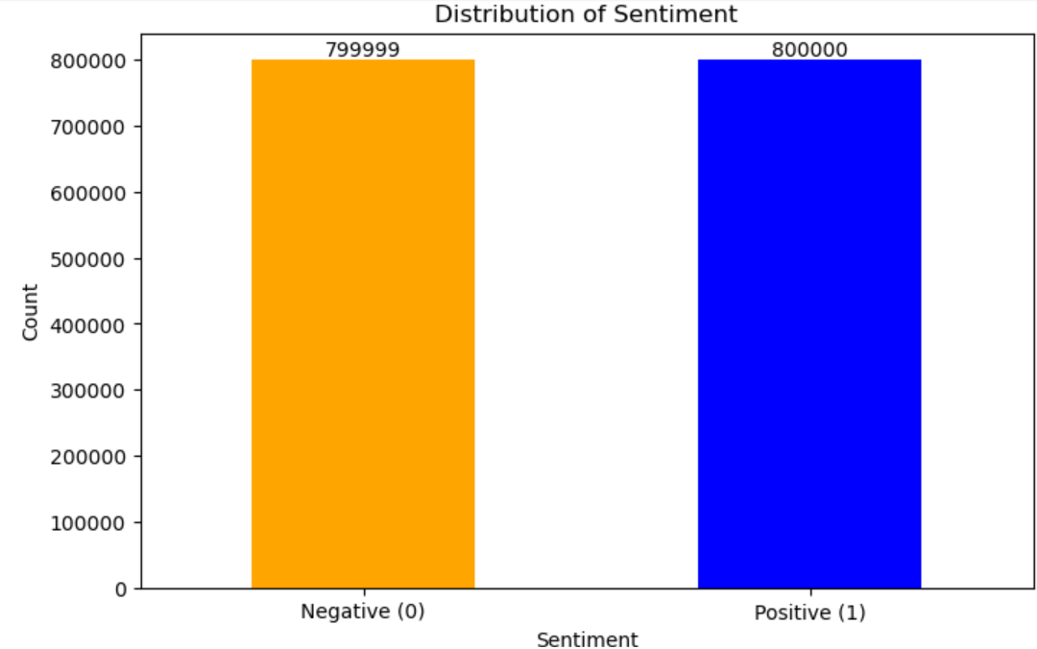
Visuals for NLP
Here, the x-axis represents the two sentiment classes: "Negative (0)" and "Positive (1)". The y-axis shows the count of instances in each sentiment class.
The orange bar represents the count of "Negative" samples, totaling 799,999. The blue bar represents the count of "Positive" samples, totaling 800,000.

Slide 12
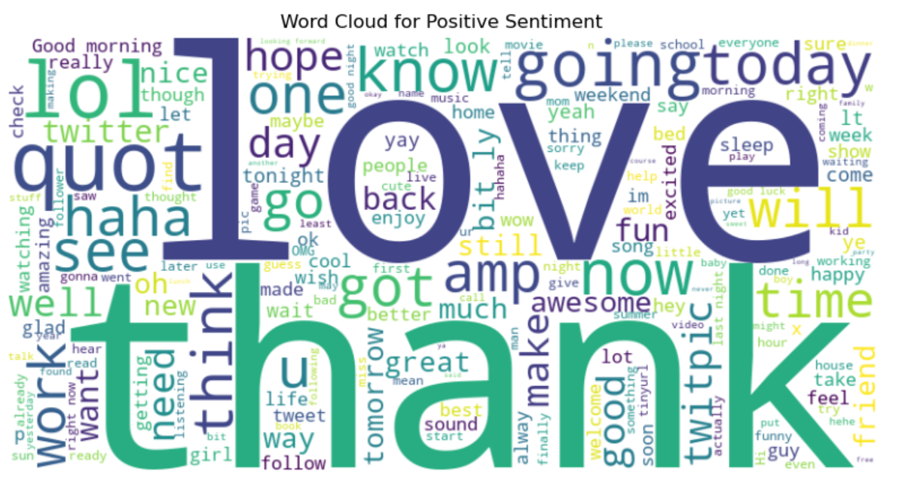
Visuals for NLP
Large words represent the most frequently used words, while smaller words appear less often in the positive sentiment texts.
Prominent words like "love," "thank," "lol," "going," "today," "haha," "good," "time," and "happy" suggest commonly positive expressions and topics.

Slide 13
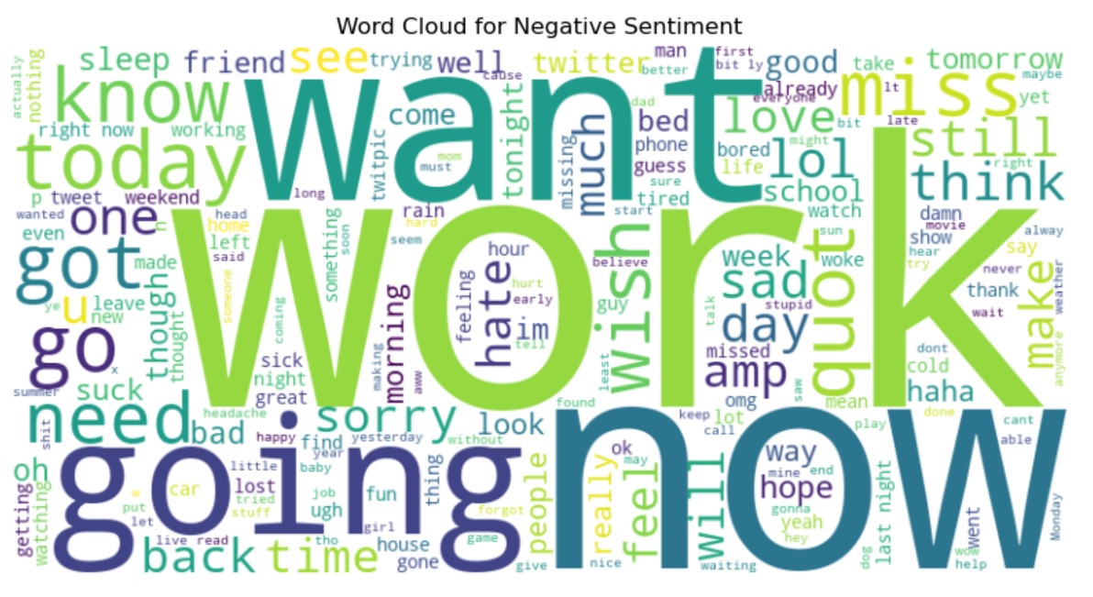
Visuals for NLP
The image displays a word cloud generated from text data with negative sentiment. Prominent words like "work", "want", "going", "wish", and "know" appear larger, indicating their frequent occurrence in the dataset.
The word cloud provides a quick, visually engaging summary of the most common terms in the negative sentiment data, offering insights into the main themes present in the text.

Slide 14
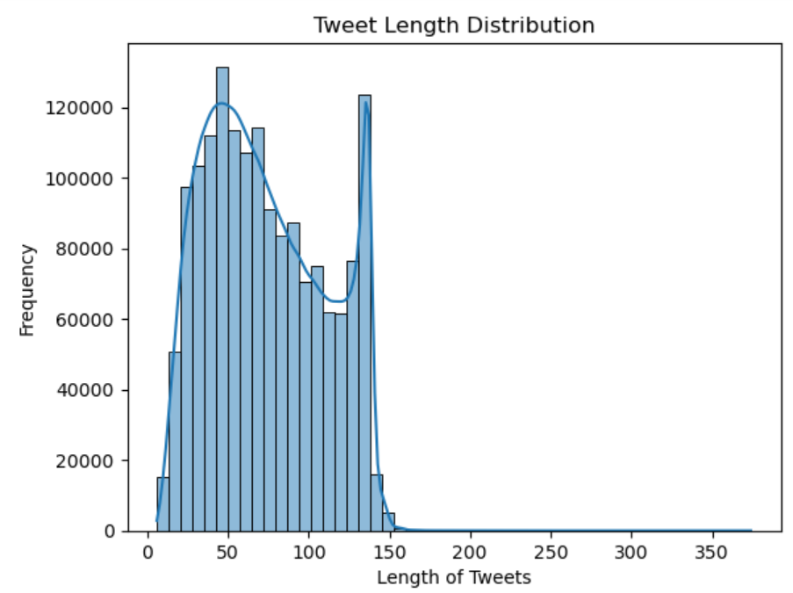
Visuals for NLP
The graph depicts a histogram of tweet lengths, with the x-axis showing character count (0 to 350) and the y-axis representing frequency.
The data suggests a preference for concise tweets, aligning with typical Twitter usage. A slight increase in frequency towards the higher character counts indicates some users maximizing the available space.

Slide 15

General Solutions for NLP
Text- preprocessing in NLP involves
Pre-processing Text- Noise Removal
Tokenization & Lemmatization
Stopword Removal
Feature Engineering & Model Training
TF-IDF Vectorization
Machine Learning Models
Evaluation

Slide 16
Text Pre-Processing
1. Text Cleaning
Removed URLs, hashtags, mentions, punctuation, and numbers.
Lowercased all text for consistency.
2. Tokenization
Split text into individual words using word_tokenize.
3. Stopword Removal
Removed common, uninformative words like "the", "is", "and"

Slide 17
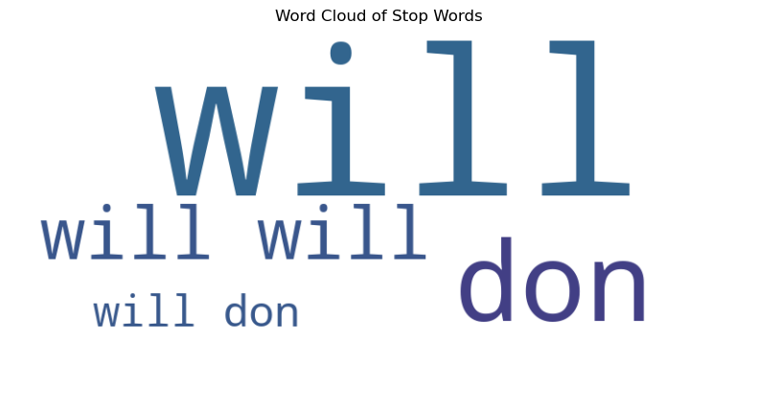
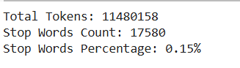
Stop Words Analysis
Identify frequent stop words (e.g., "the", "is", "and") to understand their distribution in the dataset.
Removing these words enhances the focus on meaningful text for analysis.

Slide 18
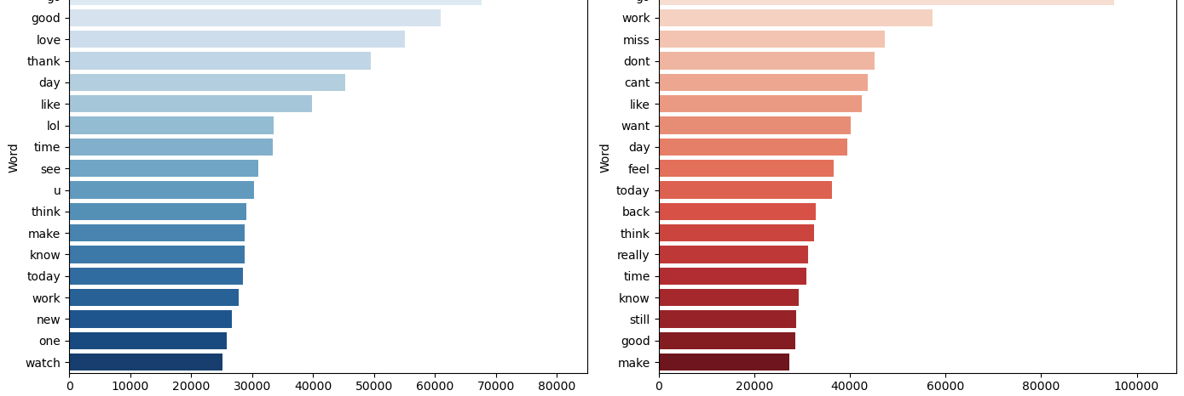
Stop Words Analysis
Identify commonly used words in positive and negative tweets.
Understand the context of sentiment classification.
Positive tweets often include words indicating praise or happiness.
Negative tweets frequently feature words expressing dissatisfaction or criticism.

Slide 19
Feature Extraction Using TF-IDF
Transforming the Text using TF-IDF
Token Joining:
Filtered tokens from each tweet were joined into strings suitable for vectorization.
TF-IDF Transformation:
Used TF-IDF Vectorizer from scikit-learn to convert text into a matrix of TF-IDF features
The TF-IDF score captures the importance of terms within and across tweets.
Matrix Shape:
The resulting matrix shape: (1,599,999 tweets, 418,079 features).
This sparse matrix serves as input for the machine learning model.

Slide 20
Machine Learning Models & Evaluations
Models Implemented for Sentiment Analysis:
Logistic Regression: A linear model for binary classification.
Naïve Bayes: A probabilistic model based on Bayes' theorem, effective for text classification.
Random Forest: An ensemble method using multiple decision trees for better accuracy.
Gradient Boosting: Another ensemble technique that builds trees sequentially to improve predictions.
MLP Classifier: A neural network model that can capture complex patterns in data.

Slide 21
Model Evaluation & Comparison
Model | Accuracy | Precision (Class 0) | Recall (Class 0) | F1 score (Class 0) | Precision (Class 1) | Recall (Class 1) | F1 (Class 1 )
Logistic regression | 0.78 | 0.79 | 0.76 | 0.77 | 0.77 | 0.80 | 0.78
Naïve bayes | 0.76 | 0.75 | 0.77 | 0.76 | 0.76 | 0.75 | 0.76
Random forest | 0.73 | 0.75 | 0.69 | 0.72 | 0.72 | 0.77 | 0.74
Gradient boosting | 0.64 | 0.79 | 0.37 | 0.50 | 0.59 | 0.90 | 0.71
MLP classifier | 0.78 | 0.78 | 0.79 | 0.78 | 0.78 | 0.78 | 0.78

Slide 22
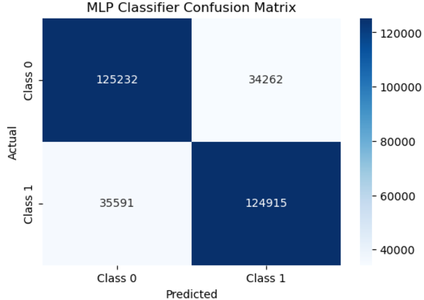
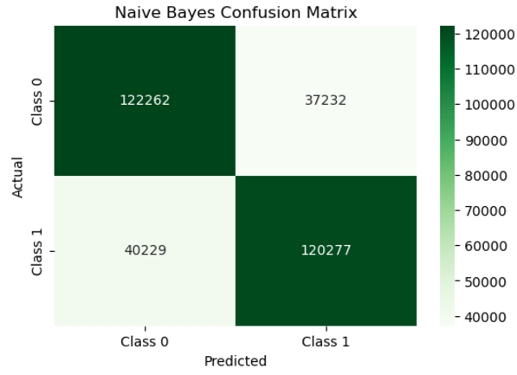
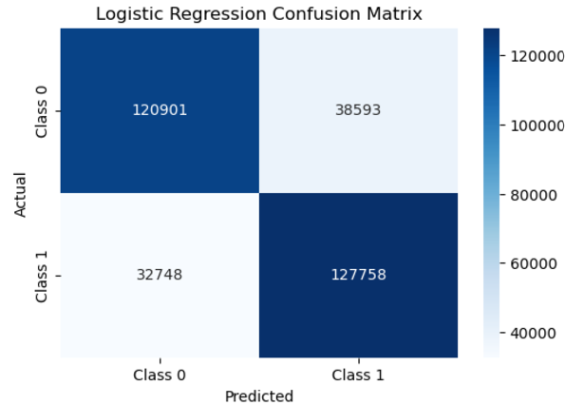
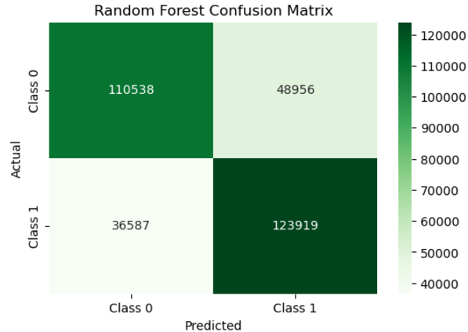
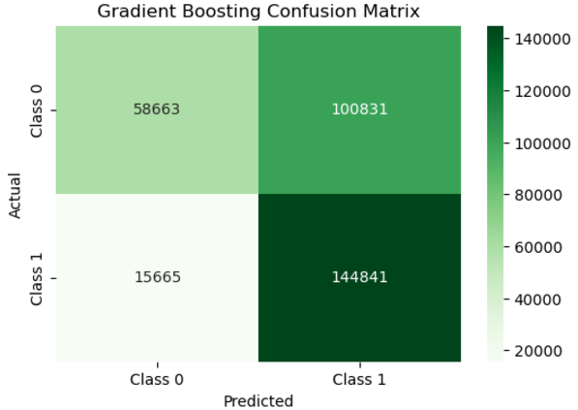
Confusion matrixes:
A confusion matrix compares expected and actual values to evaluate categorization models.

Slide 23
Association Rule Mining:
Identifies frequent patterns in text data (e.g., common word combinations).
Useful for understanding co-occurrence relationships in tweets.
Offers insights into sentiment trends and thematic patterns in text.
Methods Used:
Apriori Algorithm: For frequent itemset generation.
Association Rules: Metrics like Support, Confidence, and Lift.

Slide 24
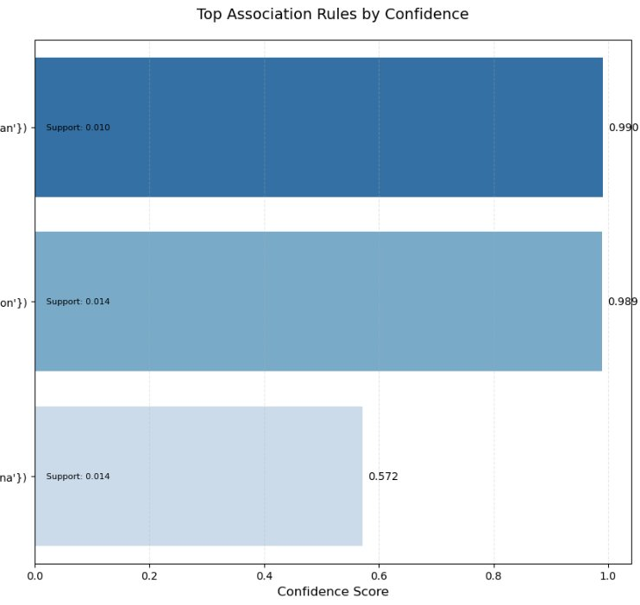
This bar plot showcases the top rules based on confidence scores while annotating their support values.
Rules with high confidence and support are ideal for making decisions. The rule for 'wan' is highly reliable but less frequent, whereas 'gon' and 'na' are more frequent but slightly less confident.

Slide 25
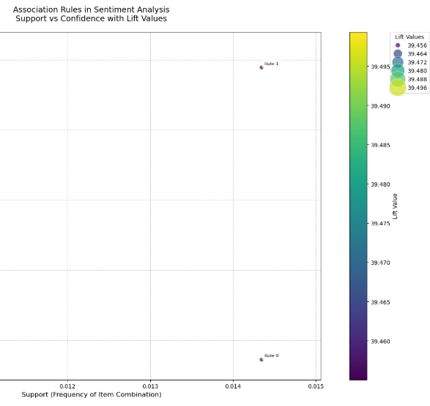
The scatter plot visualizes association rules in terms of their support, confidence, and lift values.
Rules with higher confidence and lift are more impactful, as they are both reliable and significant.

Slide 26
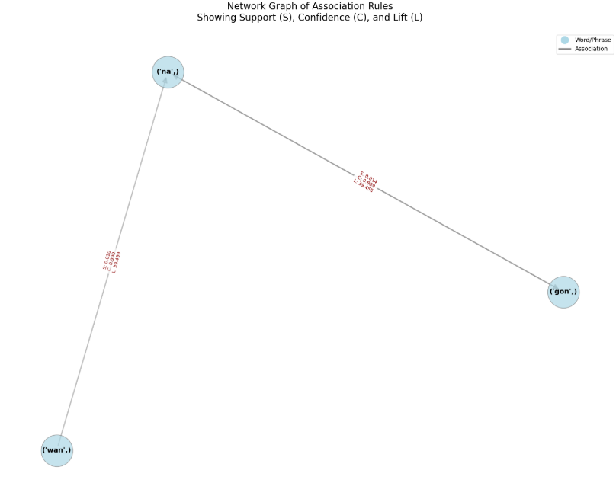
This network graph demonstrates the relationships among terms or phrases that often appear together in contexts of positive or negative sentiment.

Slide 27

Results
Model Performance Summary:
Naive Bayes: Accuracy: 76%, F1 Score: 0.76
Random Forest: Accuracy: 73%, F1 Score: 0.74
Gradient Boosting: Accuracy: 64%, F1 Score: 0.71
MLP Classifier: Accuracy: 78%, F1 Score: 0.78
Logistic Regression: Accuracy: 78%, F1 Score: 0.78
Logistic Regression and MLP Classifier performed the best with 78% Accuracy and 0.78 F1 Score.

Slide 28
Conclusion and Future Scope
Conclusion:
Successfully classified tweets into positive and negative sentiments using robust preprocessing (e.g., tokenization, TF-IDF vectorization).
Logistic Regression and MLP Classifier achieved the best results with 78% accuracy and 0.78 F1-score.
Association Rule Mining revealed key co-occurrences, providing insights into sentiment trends (e.g., "love" and "happy" in positive tweets).
Challenges included noisy data and limited contextual understanding in simpler models.
Future Scope:
Integrate advanced NLP models like BERT or GPT for better context handling.
Expand to real-time and multilingual sentiment analysis for broader applications.
Enhance Association Rule Mining to uncover deeper patterns for actionable insights.

Slide 29

Presentation and Demo Links
Presentation Link: https://video.kent.edu/media/Group-6_DMT_PPT/1_p9ldszpg
Demo Link: https://video.kent.edu/media/DMT+demo/1_elbc5ttm

Slide 30
Thankyou

